Slide 1
Trust Simulation and Modeling Using Iterated Prisoner’s Dilemma
Arief Rahman – 23516008
IF5161 (Model & Simulasi)

Slide 2
Background
Less and less people trusting each other than in the past (source: https://ourworldindata.org/trust), despite the fact that human has a systemic bias to cooperate (Fehr & Fischbacher, 2003 [1])
Trust on each other evolved into distrust as time goes on (case study USA)
Many factors to trust evolution:
Repeated interactions with a certain entity
Adaptation based on environment
Misunderstanding (Case, 2017 [3])
Extortion Tactic (Stewart and Plotkin, 2012 [6])

Slide 3
Goal
Determine how repeated interactions, adaptation, misunderstanding, and extortion tactics change how trust evolves in an environment
Allows us to create general guidelines on how to achieve better trust environment for everyone
Can be used as a tool to show the effects of trust evolution on society
How to simulate trust evolution? Game theory: (Iterated) Prisoner’s Dilemma

Slide 4
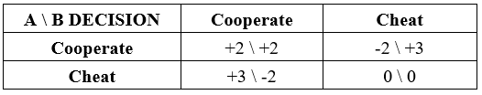
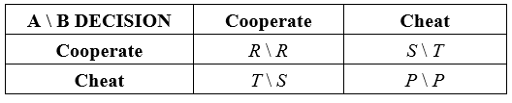
Prisoner’s Dilemma
One of the most standard games analyzed in game theory [2]
Rules:
Two players, each given an option whether to cooperate with or cheat the other player
Each player gets or loses points depending on both players’ choice
Not good for simulating trust
Best option is always cheating

Slide 5
Iterated Prisoner’s Dilemma
Almost exactly the same as the original prisoner’s dilemma
Only difference: repeated games between two same players
Allows a player to look at both players’ past decisions, allowing them to update how they decide their action
Much more fitting for trust evolution modeling & simulation
Each agent uses a certain decision-making strategy which adapts according to both players’ past choices

Slide 6
Example Decision Strategies
Always cooperate : Cooperate no matter what
Always cheat : Cheat no matter what
Copycat : Copy opponent’s last action (a.k.a. Tit for Tat)
Grudger : Cooperate until cheated at least once. Always cheat afterwards
Random : Random action (50-50 chance)

Slide 7
Related Studies (1)
Axelrod (1980a; 1980b) [4,5]
Round robin tournament style of iterated prisoner’s dilemma
Tallies score of each agent from multiple rounds of tournament
Many varieties of decision-making agents
Main takeaway: Four fundamental properties for good-performing agents: Nice, Retaliating, Forgiving, Non-envious
Limitation: No misunderstanding factor, no low-performing agents adaptation

Slide 8
Related Studies (2)
Case’s Simulation (2017) [3]
Same as Axelrod’s setting, but also includes misunderstanding
At the end of each tournament round, agents with lowest scores will adopt the best-performing agent’s strategy
Main takeaway:
Forgiveness allows better performances in repeated interactions
Trust breaks down in high level of misunderstanding
Being forgiving resulted in a much better trust environment when misunderstanding level is low
Limitation: Limited decision-making agent variety (all deterministic, except for Random), does not include smart exploitative agent type

Slide 9
Related Studies (3)
Stewart and Plotkin (2012) [6]
Same format as Axelrod tournament
Different set of strategies
New extortion tactics discovered by Press & Dyson (2012) [7] → Zero-Determinant
Most strategies from Case (2017) [3]
Result:
Extortion tactics dominate the game
Head-to-head IPD
Extortion fosters forced cooperation from other players
Players who betray constantly placed on the bottom (even worse than cooperator).

Slide 10
Our Model & Simulation Proposal
Merging Axelrod’s and Steward & Plotkin’s agent variety with Case’s simulation setting
Iterated prisoner’s dilemma, round robin tournament styles
Customization in simulation input (similar to Case’s):
List of agents
Outcome chart (cooperate x2, cooperate-cheat, and cheat x2)
Number of games per tournament round for each agent pair
Number of tournament rounds
Mistake probability (doing the opposite action to current decision rule)
Mistake bias → Only allows doing opposite action for cooperation
Number of adapting agents per tournament round
Changes:
Using Axelrod’s agents list, in addition to Case’s
Adding mistake bias

Slide 11
Our Model & Simulation Goal
Reinforce the Axelrod’s and Case’s conclusions
Explore the effects of probabilistic decision-making agents on trust simulation with misunderstanding factor
Explore the effects of mistake bias in trust simulation

Slide 12
Implementation
Implemented in Python 3.6
Using axelrod library (http://axelrod.readthedocs.io)
Added mistake bias and Detective agent
Implemented Case’s simulation using axelrod library

Slide 13
Experiment Scenarios (1)
Differentiation in list of agents
No. | Simulation | Strategies Used | Description
1 | Axelrod’s first tournament | Tit-for-Tat, Tideman and Chieruzzi, Nydegger, Grofman, Shubik, Stein and Rapoport, Grudger, Davis, Revised Downing, Feld, Joss, Tullock, Unnamed Strategy, Random (50-50) | All strategies except Graaskamp are accounted
2 | Axelrod’s second tournament | Axelrod’s first tournament strategies, Black, Borufsen, Cave, Champion, Colbert, Eatherley, Getzler, Gladstein, Go by Majority, Graaskamp & Katzen, Harrington, Kluepfel, Leyvraz, Mikkelson, More Grofman, More Tideman and Chieruzzi, Richard Hufford, Tester, Tranquilizer, Weiner, White, Wm Adams, Yamachi | Less than half of the strategies present are accounted
3 | Case simulation | Cooperator, Cheater (Defector), Copycat (Tit-for-Tat), Detective, Grudger, Copykitten (Tit-for-Two-Tats), Simpleton (Win-Stay-Lose-Shift), Random (50-50) | Detective strategy is not available in the library, but can be easily implemented
4 | Steward and Plotkin’s tournament | Case’s simulation strategies (except Detective), ZD Extort-2, Hard Go by Majority, Hard Tit-for-Tat, Hard Tit-for-Two-Tats, Generous Tit-for-Tat, ZD Generous Tit-for-Tat 2, Calculator, Prober, Prober 2, Prober 3, Hard Prober, Naïve Prober, Random (50-50) | All strategies are accounted. Detective strategy is not present in the original tournament.
5 | Best players from 1, 2, 3, and 4 | Stein and Rapoport, Grudger, Revised Downing, Tit-for-Tat, Davis, Nydegger, Cave, Tranquilizer, White, Eatherley, Champion, Harrington, Defector, Random, Win-Stay-Lose-Shift, Generous Tit-for-Tat, ZD Generous-Tit-for-Tat 2, Tit-for-2-Tats, Naïve Prober, Hard Prober | -

Slide 14
Experiment Scenarios (2)
Differentiation in tournament types
Axelrod : To analyze agent’s performance in one round
Case : To analyze multiple interaction, misunderstanding, extortion, and adaptation
Differentiation in mistake and mistake bias (Case’s simulation only)
No mistake
Mistake 0.05, no mistake bias
Mistake 0.05, with mistake bias
Mistake 0.2, no mistake bias
Mistake 0.2, with mistake bias
Use multiple seeds → Prevent random bias

Slide 15
Experiment Scenarios (3)
Shared parameters:
Number of rounds per tournament match: 200
Maximum number of match: 50
Number of agents to replace per match: 1
Outcome chart:
A \ B DECISION | Cooperate | Cheat
Cooperate | 3 \ 3 | 0 \ 5
Cheat | 5 \ 0 | 1 \ 1

Slide 16
Result

Slide 17
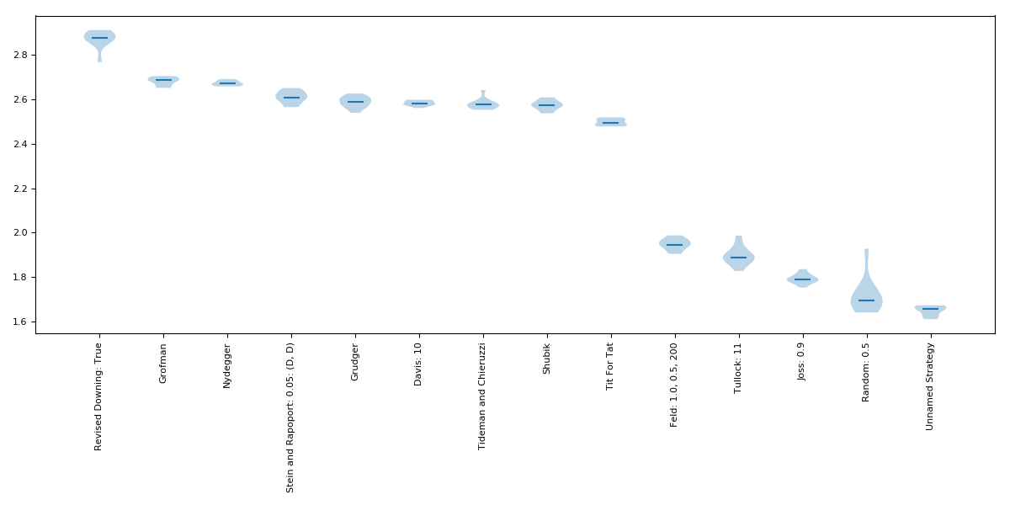
Type : Axelrod Tournament Players : Axelrod first tournament

Slide 18
Type : Axelrod Tournament Players : Axelrod first tournament
Surprising result, considering Tit-for-Tat is always considered number 1 in the original paper
Revised Downing

Slide 19
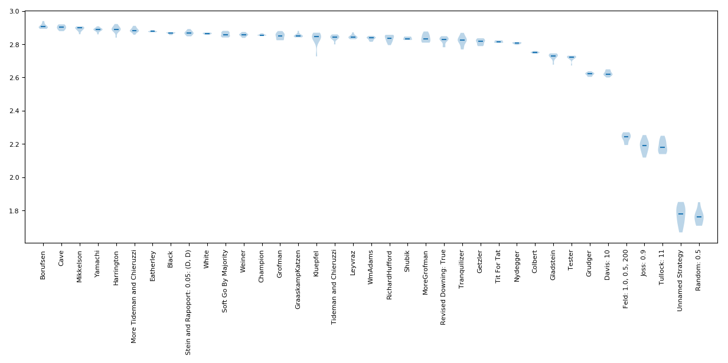
Type : Axelrod Tournament Players : Axelrod second tournament

Slide 20
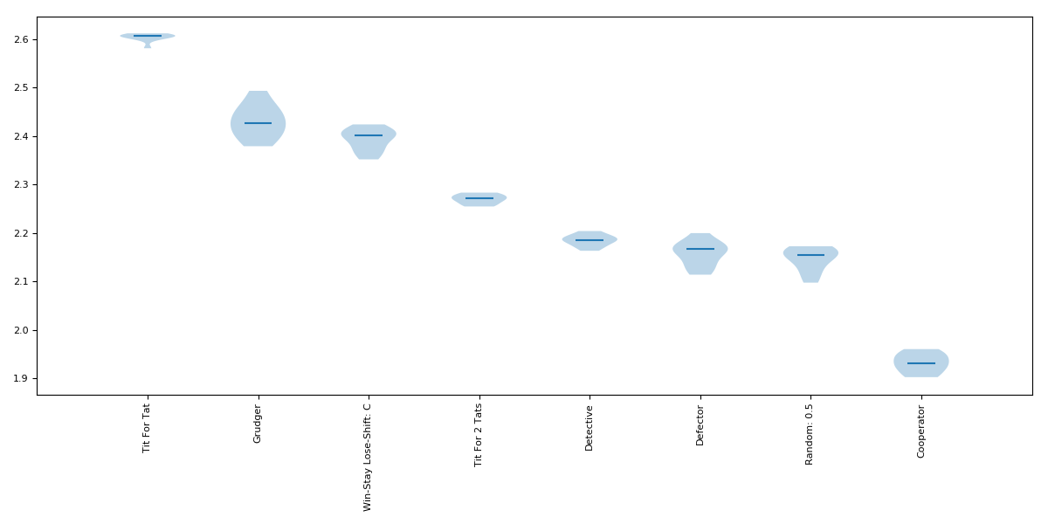
Type : Axelrod Tournament Players : Case

Slide 21
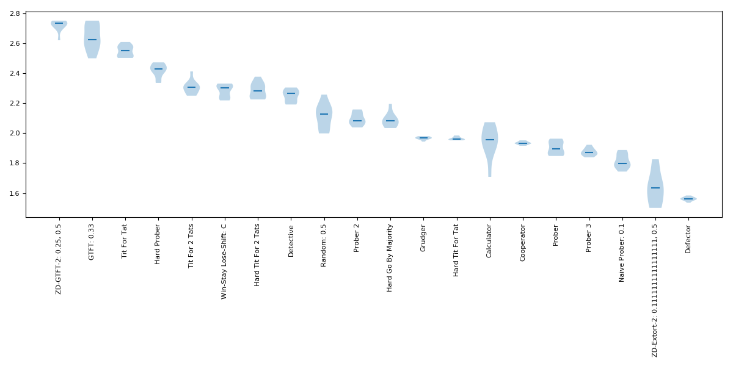
Type : Axelrod Tournament Players : Stewart-Plotkin

Slide 22
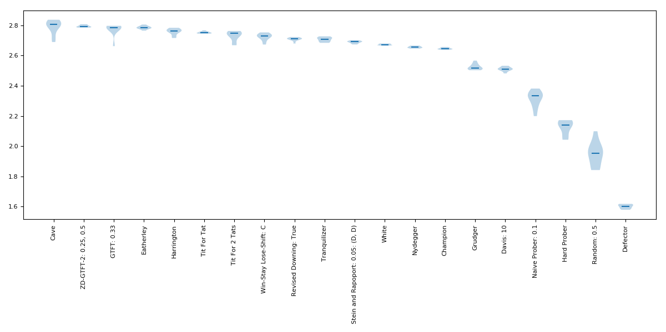
Type : Axelrod Tournament Players : Best
Notes:
Seed = 1

Slide 23
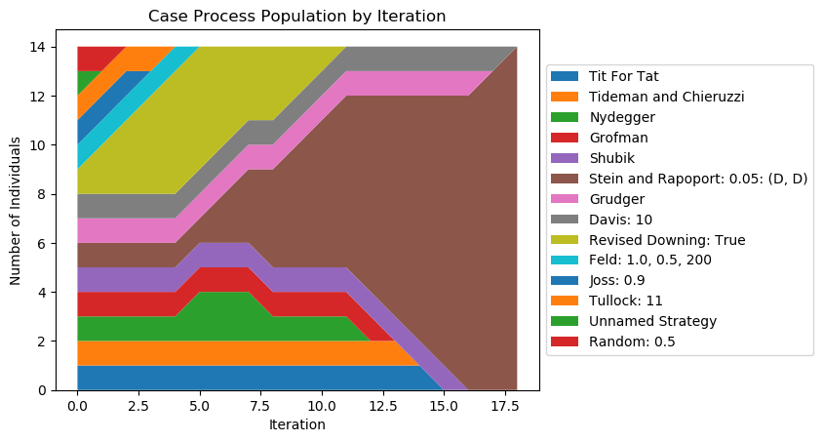
Type : Case Players : Axelrod first tournament
Notes:
Seed = 4750670

Slide 24
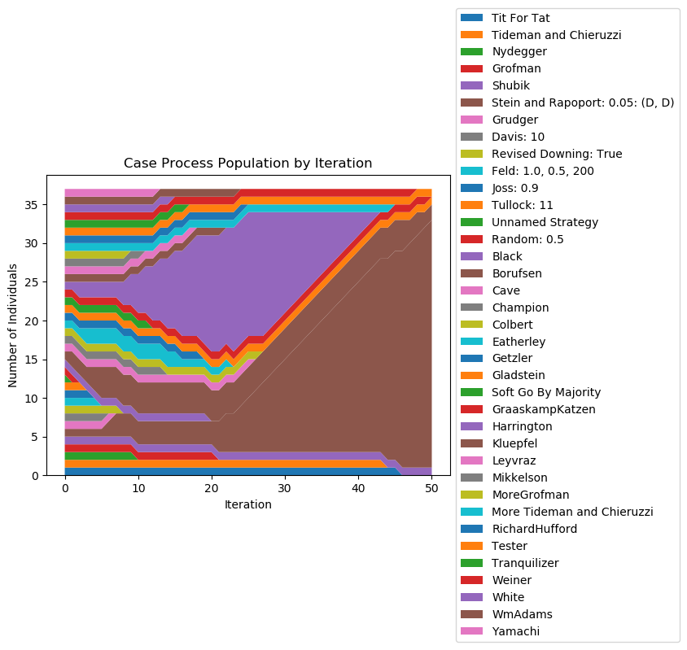
Type - Case Players - Axelrod second tournament
Notes:
Seed = 51161

Slide 25
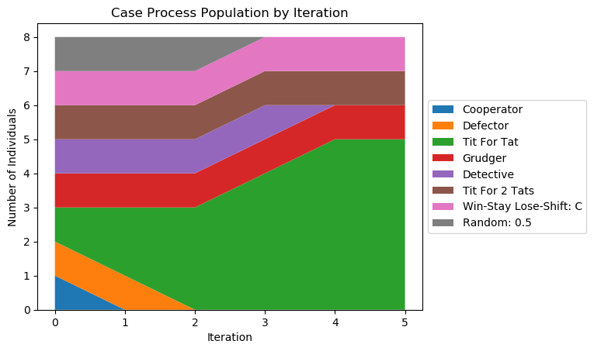
Type : Case Players : Case

Slide 26
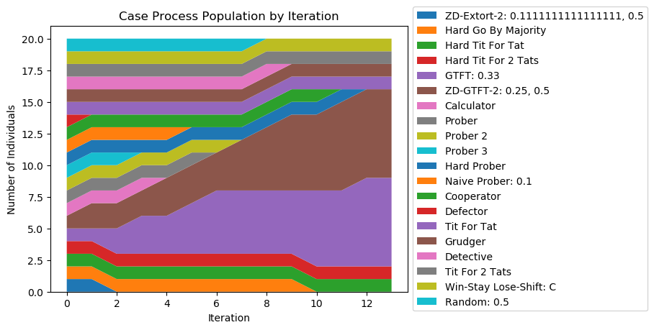
Type : Case Players : Stewart-Plotkin
Notes:
Seed = 4750670

Slide 27
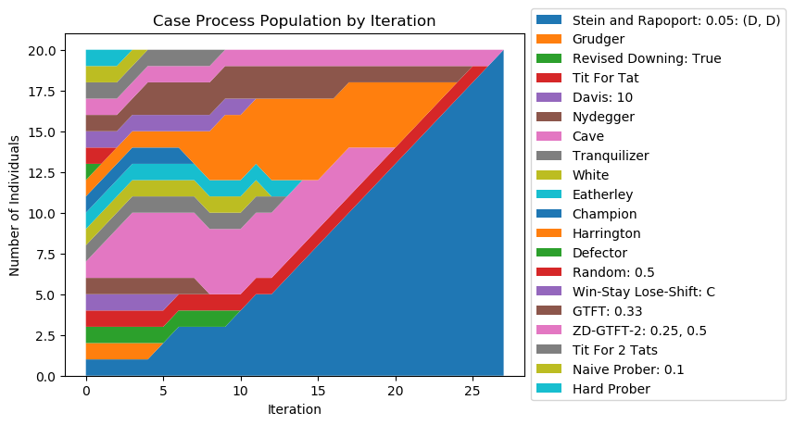
Type : Case Players : Best
Notes:
Seed = 901236547

Slide 28
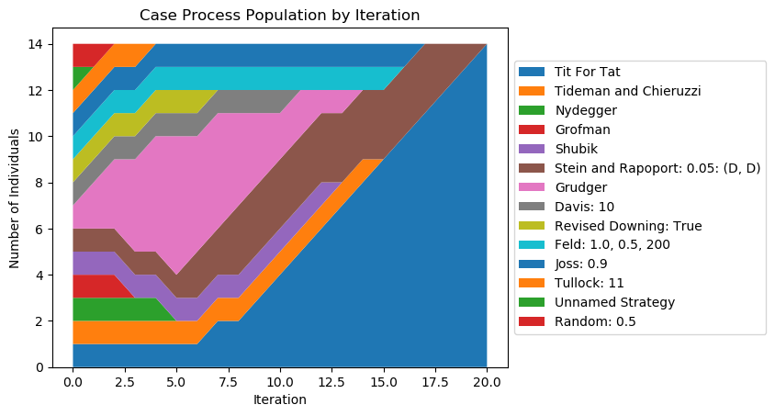
Type : Case, mistake 0.05, no bias Players : Axelrod first tournament
Notes:
Seed = 291358764

Slide 29
Type : Case, mistake 0.05, no bias Players : Axelrod first tournament
Tit-for-Tat dominates 6 out of 10 cases
Stein & Rapoport dominates 4 out of 10 cases

Slide 30
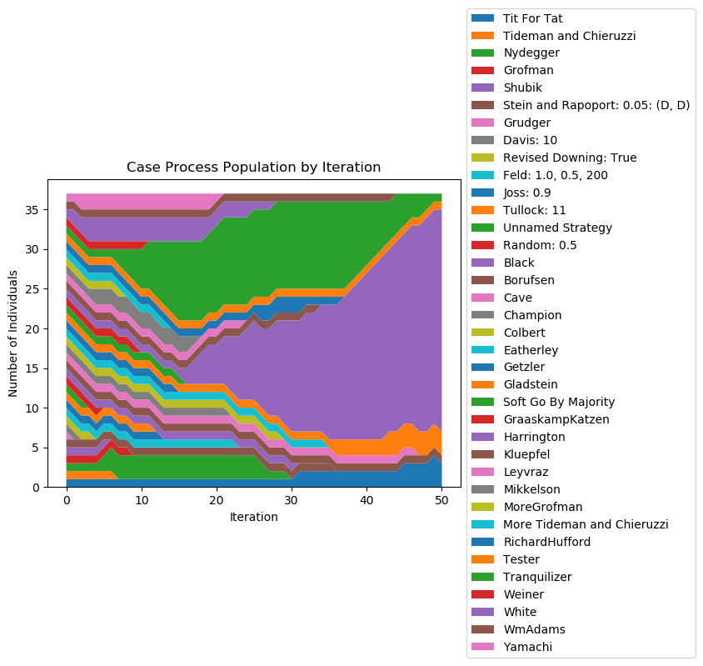
Type - Case, mistake 0.05, no bias Players - Axelrod second tournament
Notes:
Seed = 4750670

Slide 31
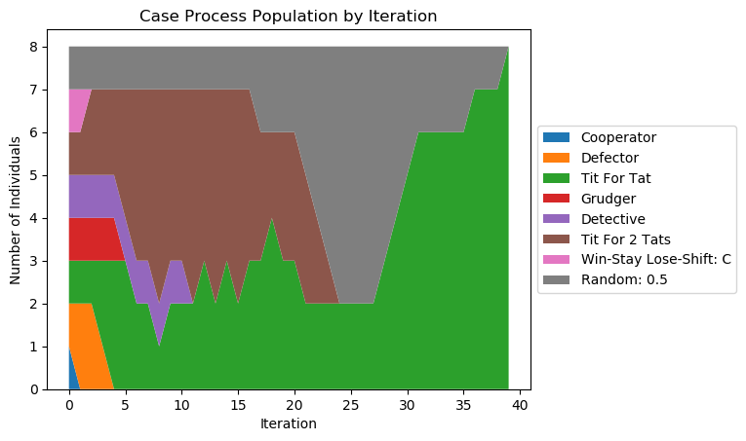
Type : Case, mistake 0.05, no bias Players : Case
Notes:
1143278

Slide 32
Type : Case, mistake 0.05, no bias Players : Case
Mixed bag
Tied domination between Defector, Tit-for-Two-Tats, and Tit-for-Tat
7 out of 10, Defector managed to survive to the end
Most of the cases, Defector got defeated by Tit-for-Tat
Tit-for-Tat has the most consistent performance

Slide 33
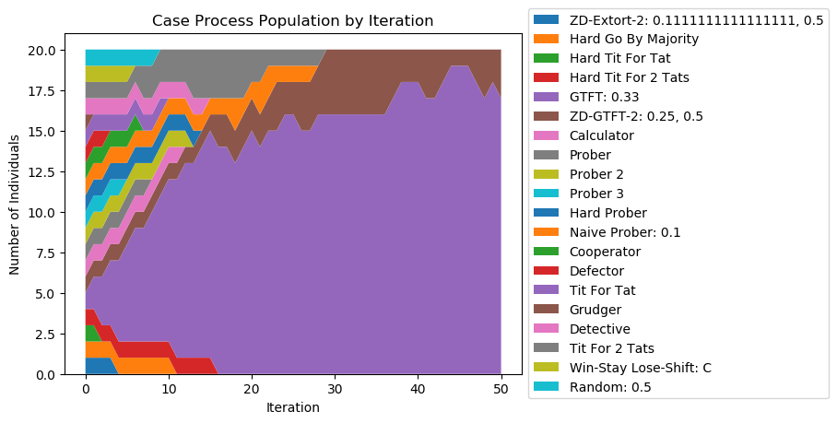
Type : Case, mistake 0.05, no bias Players : Stewart-Plotkin
Notes:
1143728

Slide 34
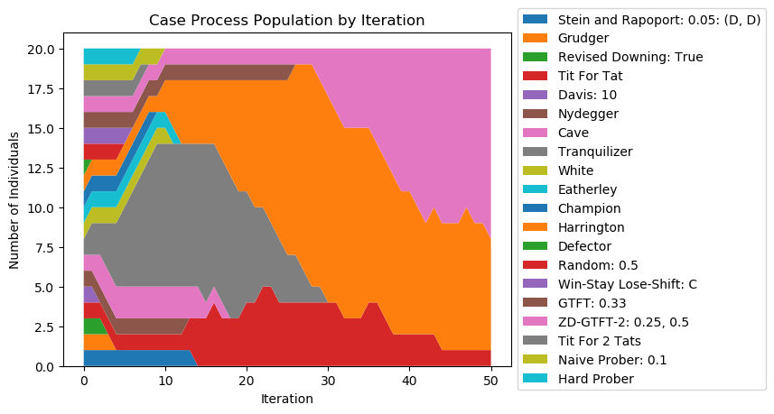
Type : Case, mistake 0.05, no bias Players : Best
Notes:
771923

Slide 35
Type : Case, mistake 0.05, with bias Players : Axelrod first tournament
VERY mixed bag
Common outcomes:
Grudger dominates for half of the tournament, before getting replaced (8 out of 10)
Stein & Rapoport dominates (3 our of 10)
Tideman & Chieruzzi dominates (7 out of 10)
Defector survives for half of the tournament, before getting replaced (9 out of 10)

Slide 36
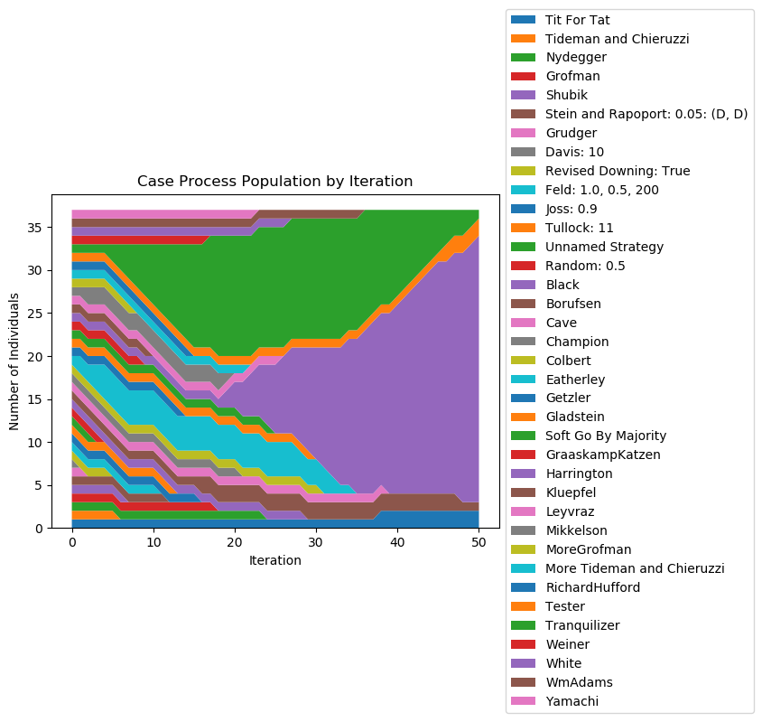
Type - Case, mistake 0.05, with bias Players - Axelrod second tournament
Notes:
4750670

Slide 37
Type : Case, mistake 0.05, with bias Players : Axelrod second tournament
Not as mixed bag as the previous experiment
Common observations:
Black dominates in all cases
Richard Hufford have a big share to the end (2 out of 10)
Tranquilizer survived through 4/5 of the tournament in all cases
Eatherley has increased members, but ended up replaced in all cases

Slide 38
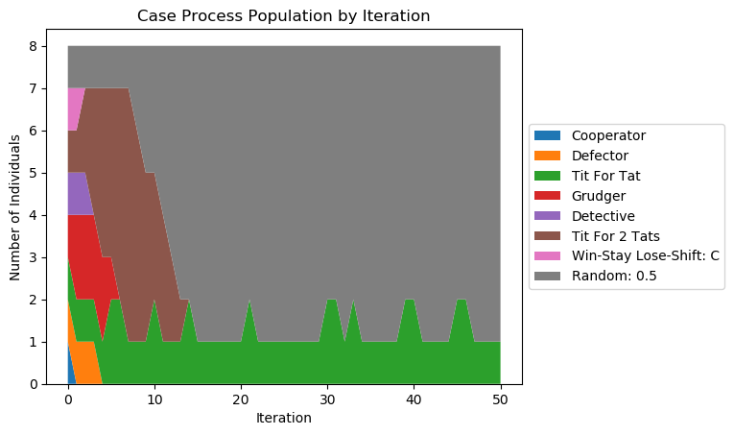
Type : Case, mistake 0.05, with bias Players : Case
Notes:
291358764

Slide 39
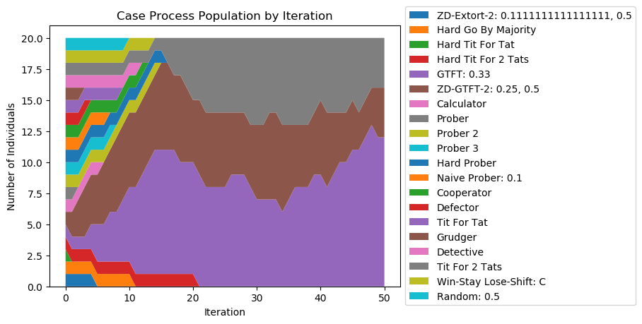
Type : Case, mistake 0.05, with bias Players : Steward-Plotkin
Notes:
51161

Slide 40
Type : Case, mistake 0.05, with bias Players : Steward-Plotkin
Consistently dominated by GTFT
Trailed behind by ZD-GTFT-2
Tit-for-Two-Tats occasionally survived to the end (5 out of 10)

Slide 41
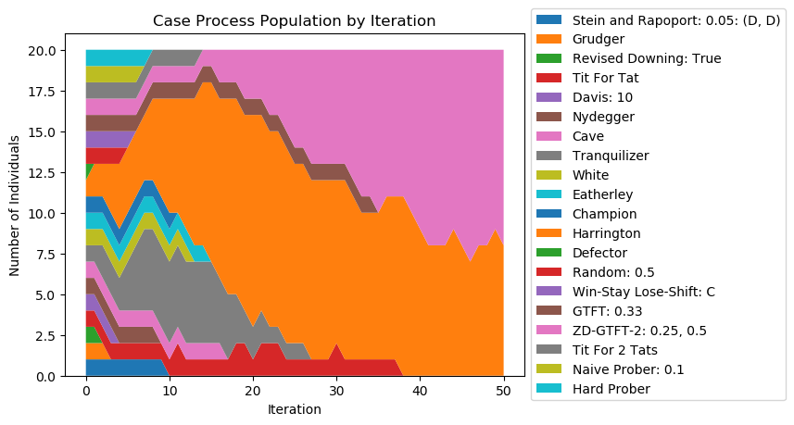
Type : Case, mistake 0.05, with bias Players : Best
Notes:
4750670

Slide 42
Type : Case, mistake 0.05, with bias Players : Best
Harrington and Cave dominated once again
GTFT occasionally survived (4 out of 10)

Slide 43
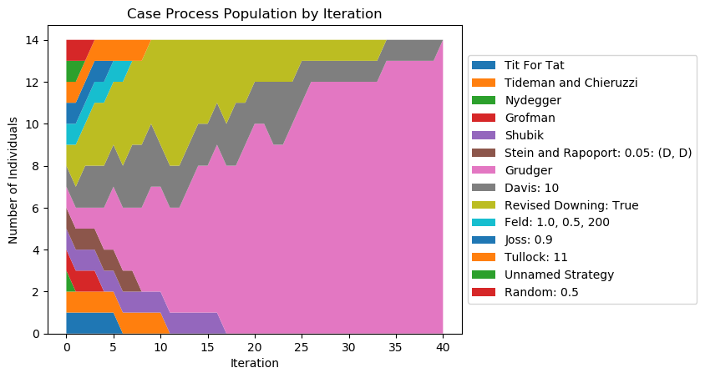
Type : Case, mistake 0.2, no bias Players : Axelrod first tournament
Notes:
901236547

Slide 44
Type : Case, mistake 0.2, no bias Players : Axelrod first tournament
Grudger always dominates in the end
Davis and Revised Downing often trails behind (6 out of 10)

Slide 45
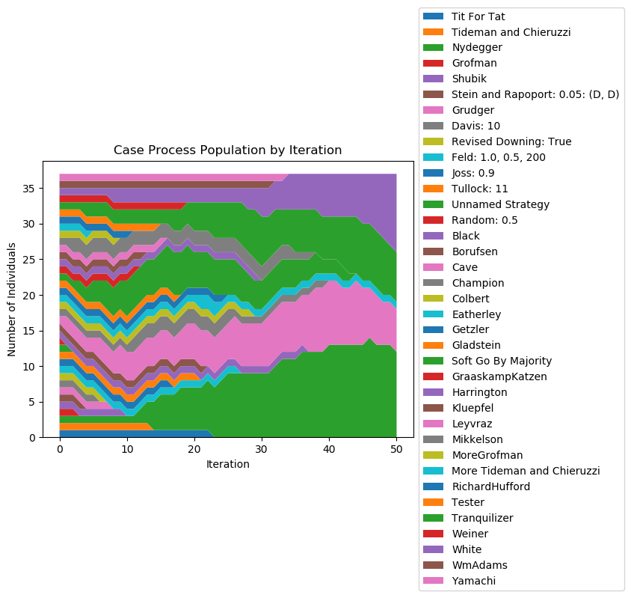
Type - Case, mistake 0.2, no bias Players - Axelrod second tournament

Slide 46
Type : Case, mistake 0.2, no bias Players : Axelrod second tournament
Another very mixed bag
White often has big shares of members (6 out of 10)
Tranquilizer almost always survives with big shares (9 out of 10)
Richard Hufford sometimes have big shares (2 out of 10)

Slide 47
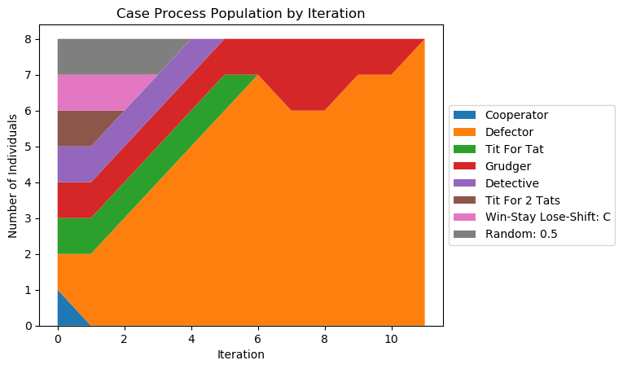
Type : Case, mistake 0.2, no bias Players : Case
Notes:
34293471

Slide 48
Type : Case, mistake 0.2, no bias Players : Case
One of these outcomes always happens:
Grudger dominates
Defector dominates
ALL other members always got replaced by the end

Slide 49
Type : Case, mistake 0.05, with bias Players : Case
Most of the time dominated by Defector
In this case, Tit-for-Tat always trails behind, but manages to survive throughout the whole simulation
If Defector got replaced at the beginning phase, Tit-for-Tat or Tit-for-Two-Tats dominates

Slide 50
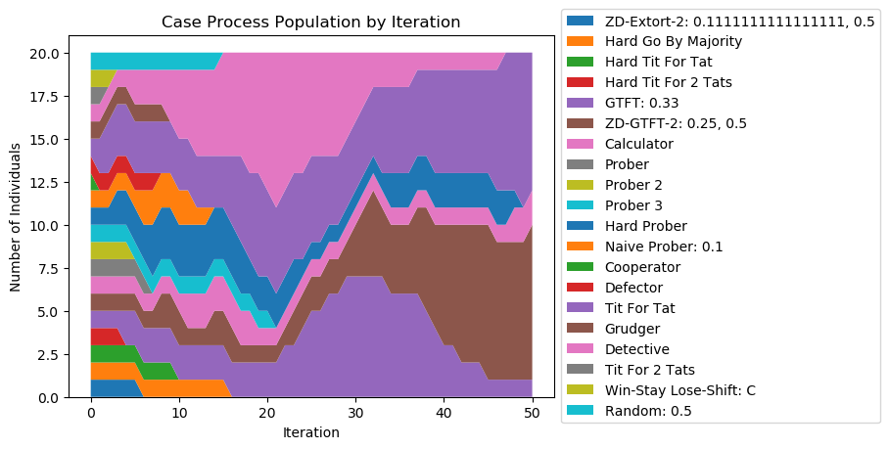
Type : Case, mistake 0.2, no bias Players : Steward-Plotkin
Notes:
291358764

Slide 51
Type : Case, mistake 0.2, no bias Players : Steward-Plotkin
No clear winner:
Fierce competition between
Detective
Tit-for-Tat
GTFT
ZD-GTFT-2
Common observations:
Calculator occasionally survive through the end (4 out of 10)

Slide 52
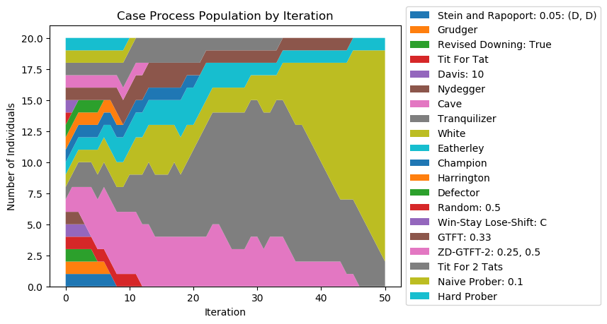
Type : Case, mistake 0.2, no bias Players : Best
Notes:
1

Slide 53
Type : Case, mistake 0.2, no bias Players : Best
Two winners in most cases:
White (7 out of 10)
Tranquilizer (3 out of 10)
Eatherley mostly trails behind (4 out of 10) before getting replaced (7 out of 10) → Also the last member to be replaced mostly (8 out of 10)

Slide 54
Conclusion
Adaptability is another good trait to have on IPD.
Adaptable Tit-for-Tat works the best on environment with low mistake probability
ZD strategies surprisingly don’t always work the best in Case’s simulation
In high distrust environment, strategies that has big retaliation or tend to defect has the best chance

Slide 55
References
[1] E. Fehr and U. Fischbacher, “The nature of human altruism -- Proximate and evolutionary origins.,” Nat. Mater., vol. 425, no. October, pp. 785–791, 2003.
[2] B. von Stengel, “Game Theory Basics,” 2007.
[3] N. Case, “The Evolution of Trust,” 2017. [Online]. Available: http://ncase.me/trust/. [Accessed: 07-Feb-2018].
[4] R. Axelrod, “Effective choice in the prisoner’s dilemma,” J. Conflict Resolut., vol. 24, no. 1, pp. 3–25, 1980.
[5] R. Axelrod, “More effective choice in the prisoner’s dilemma,” J. Conflict Resolut., vol. 24, no. 3, pp. 379–403, 1980.
[6] A. J. Stewart dan J. B. Plotkin, “Extortion and cooperation in the Prisoner’s Dilemma,” Proc. Natl. Acad. Sci., vol. 109, no. 26, hal. 10134–10135, 2012.
[7] W. H. Press dan F. J. Dyson, “Iterated Prisoner’s Dilemma contains strategies that dominate any evolutionary opponent,” Proc. Natl. Acad. Sci., vol. 109, no. 26, hal. 10409–10413, 2012

Slide 56
Thank You

